Slide 1

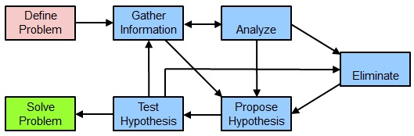
Maintenance schedule:
Backups, upgrades, security, auditing.

Slide 2
As you troubleshoot different cases, keep in mind that different approaches might suit different cases.
Depending on the case, the approach you take might be top down, bottom up, follow the path, or a hybrid method.
The key is to have an approach and follow through, documenting all discoveries or changes.
No matter which method is used, the basic elements should include those shown in the previous workflow.

Slide 3
Data Storage and Security
Best Practices for storing and securing your data
The goal of data storage is to ensure that your research data are in a safe and secure environment which is accessible, secure, and redundant.

Slide 4
Hardware and Software
Desktops and laptops – not for storage of original or only copies of data!
Removable media – not for storage of master copies. Check it yearly and migrate to new media every 3-5 years
Cloud storage
  store additional copies of data
  no sensitive data, esp. highly sensitive data
  Read terms and conditions
Notes:
Your desktop or laptop computer should store only your current working copy of your data. Your master copy should be stored in a safe environment, and it should be copied in another location as well. Data redundancy is very important.
Removable media: this covers all types of media.
USB sticks, flash cards, SD cards, etc.
Optical media, such as CDs, DVDs.
Magnetic media, such as magnetic tapes and hard drives.
They are all inherently vulnerable to temperature and humidity fluctuations, poor handling, air, moisture, and light conditions. Removable media should be migrated to new media every 3-5 years. Hard drives should be migrated every 5 years. The consistency of the recorded data should be checked yearly.
Cloud storage is a good backup option. But you need to be aware of the terms of use and privacy policies, data ownership policy, and costs. Cloud storage is not appropriate for sensitive data (HIPPA), but may be ok for moderately sensitive data (FERPA).

Slide 5
Hardware and Software
Desktops and laptops – Computer equipment can be damaged, lost, stolen.
Removable media – Media degrades over time. Software programs to read the media change and can become obsolete. Hardware changes over time, and is not always backward compatible.
Cloud storage
  Cloud providers go out of business
  Data formats change (what you upload may not be useable when you download it)
  Accidents happen. Data is corrupted, or stolen.
Notes:
Your desktop or laptop computer should store only your current working copy of your data. Your master copy should be stored in a safe environment, and it should be copied in another location as well. Data redundancy is very important.
Your laptop can break down, the hard drive can crash, your computer can be infected with a virus, your laptop is stolen. What happens if it is the ONLY copy of your data?
Removable media are vulnerable to temperature and humidity fluctuations, poor handling, air, moisture, and light conditions. The program you used to generate or analyze the data could be upgraded by the manufacturer, and it might no longer work with your data. The software has changed, and no longer runs on your computer.
Removable media should be migrated to new media every 3-5 years. Hard drives should be migrated every 5 years. The consistency of the recorded data should be checked yearly.
Cloud storage providers are providing a service for a fee. They are a business, and as such they can go bankrupt, be bought out, or be legislated out of existence. Cloud storage is simply storage. What you put in is what you get out. Don’t make the mistake of thinking of them as a long-term storage solution, like an archive. Have another option available, because if they go out of business, you may have a very limited amount of time to move your data to a new provider. You will not be able to move it directly from one service to another.

Slide 6
Servers and Network Drives
Storage, backup and recovery available
UVa Box
UVaCollab
Who is responsible?
Practical backup and recovery
Notes:
Servers are a good solution if they are available to you. Department servers are a good option. The department probably has a computer tech assigned to manage the server. They will manage the data, checking the condition of the files, and backing it up on a regular basis. They can recover your data from a backup if something bad happens to your working data.
ITS also has servers available for a fee. They can be used for secure data storage. If you are conducting funded research, the costs for the server can be budgeted into your grant. Capacities as large as a TB are available. They manage the data, and back it up routinely.
3rd party servers are available, but you need to remember to know the Terms of Use, Privacy policy, IP policy, and data security and ownership policies, just as you would with a cloud service provider. You will also have to budget their costs, either through funding or out-of-pocket.
If you have a small amount of data and files (less than 4GB total) you can also use UVaCollab and Home Directory for storage, but not for sensitive data. They are managed by ITS, and they are behind Netbadge, so they are secure.
UVa Box is available for data storage and files. You have 50GB capacity in it. You can upload files as large as 5GB. It can not be used for sensitive data. It is also behind Netbadge, so it is secure.
Remember that for hosted services, such as the ITS servers, departmental servers, UVaCollab and Home Directory, the server equipment is managed by ITS. The responsibility for the management of them is not your concern, other than to be sure that the actual data management of your content is your responsibility. But it is always a good idea to keep a second copy off-site is a different location.
For UVa Box, Box is responsible for the management of their servers (under contract w/ UVa), but you are responsible for your content.

Slide 7
File Formats
Think about the ability to use and re-use data in the future. Both for you, and for others.
Accessibility of future data because of technology changes - proactively plan for hardware and software obsolescence.
Think about who needs access to your data. Are you collaborating with someone within the University, or outside of it?
Conducting funded research - be aware of any data storage and data sharing requirements.
Think about data security.
Notes:
Plan for the future at the start of any data collection activity. You may need your data in one format to analyze it, and another to visualize it. You may want to share it with a collaborator who needs it in a specific format. Perhaps the software tool you need to use requires a format that only it has. Being aware of these requirements will make the later stages of your work easier and more productive.
Think about how software and hardware change over time. Proprietary software often has a short “shelf life”. Microsoft has changed Word quite a few times over the years. If you try to open an old 1989 copy of a Word file with the 2010 version, you will get nothing but gibberish. (The first Word program was released in 1983. It was in MS-DOS). Later versions are not always backwards compatible. The same holds true for many proprietary software products. Hardware also changes over time. Operating systems change, hard drive file formats change. The mechanical bits of computers change and break down. The data may be still on an older hard drive, but if the software that reads it is no longer available, or the bearings that spin the disc are frozen, you will never be able to access that data.
Access for your collaborators is something you need to be aware of. If they are at UVa, they are probably using the same systems as you, or the data can be migrated to a format you can both access and use. But if they are in Europe, or Asia, they may not have access to the same equipment or software. This is especially important if you are working with highly sensitive data, such as personal identifiers or HIPPA regulated data. Do your collaborators have access to your data storage environments?
Many funders, especially US government ones, require data sharing as a part of your funding. They may specify specific formats for data sharing and data storage.
Data security is an important consideration. Can you move the data easily? Consider factors such as size, security level, format. What are the requirements imposed by the funder, the institution, or collaborators?

Slide 8
Best Practices for File Formats
Formats most likely to be accessible in the future are:
  non-proprietary
  open
  documented standard commonly used by a discipline-specific research community
  standard representation (ASCII, Unicode)
  unencrypted and uncompressed
  Remember that comprehensive documentation (metadata) is essential to accurate use, and reuse, of all data.
Notes:
You will probably need to keep your working data in a proprietary format until your data analysis is finished. It is always a good idea to have your primary data file backed up in both the proprietary format you are using for analysis, and a non-proprietary one. Data redundancy is a simple but effective deterrent to unimagined software and hardware failures.
For long-term data storage (archiving) and sharing, you want to select a file format which is non-proprietary for maximum reuse potential. Open formats are best. Convert your data from proprietary formats to open or discipline-defined standards. The following list comes from the UK Data Archive, the preeminent authority on digital research data in the social sciences and humanities. [http://www.data-archive.ac.uk/create-manage/format/formats-table]
Quantitative tabular data: SPSS portable format (.por), comma-separated values (.csv), tab-delimited files (.tab), text files (.txt)
Geospatial data: ESRI Shapefile (.shp, .shx, .prj, .sbx, .sbn), TIFF (.tif, .tfw), Cad data (.dwg)
Qualitative data: XML, rich text format (.rtf), plain text data (ASCII .txt)
Digital Image data: TIFF (.tif) uncompressed
Digital Audio data: Free Lossless Audio Codec (FLAC) (.flac)
Digital Video data: MPEG-4 (.mp4), motion JPEG 2000 (.mj2)
Documentation and scripts: Rich text format (.rtf), PDF/A or PDF (.pdf), HTML (.htm), Open Document Text (.odt)
Don’t forget the metadata! Comprehensive and complete documentation is essential so that all future users can understand the data.

Slide 9
Data Security and Access Control
Network security
  Keep confidential or highly sensitive data off
  computers or servers connected to the internet
Physical security
  Access to buildings and rooms
Computer systems & files
  Use strong passwords on files and systems
  Virus protection (updated continuously and running!)
  Encryption
Notes:
The PI, or an assigned team member, should be responsible for maintaining the master copy.
Restrict write access to specific members of the team. Document and update your guidelines (include responsibilities) so if team members change, new members will know the requirements.
Record changes with your working data with Version control.
Network security: Keep highly sensitive, confidential or IP-valuable data off internet-connected servers (or behind firewalls).
Physical security: Who has access to your office and to the data files? Be careful of allowing repairs by an outside company.
Computer systems and files: Keep virus protection up to date, and active. Be sure your computer has a login password. Do not send personal or confidential data via e-mail or FTP. Encrypt your data prior to sending.
If you have IRB requirements, be sure to follow them. You may need to address data storage when acquiring consent and confidentially agreements for data users. Many IRB’s require 2 levels of security when working with sensitive or confidential data. This can be a password-secured computer in a locked office, or password-protected data files on a password-protected computer. Encryption is another option to ensure the security of data.

Slide 10
Data Backups
Reduces the risk of damage or loss
Use multiple locations (here-near-far or 3-2-1)
Create a backup schedule and put someone dependable in charge
Use reliable backup medium
Test your backup system (test file recovery, data consistency, data accuracy)
Notes:
Data redundancy is very important. Regular back-ups protect against disasters and accidental or malicious data loss. Types of problems:
Hardware failures
Software problems
Virus infection
Hacking
Power failures
Human errors
Ideally, your backup should be stored in a different zone: you want to be able to recover your data if something bad happens. If you keep your backup on the same device/media as your primary, or master, then in the case of a disaster you will lose all of it.
3-2-1 Rule: Keep 3 copies of your data. 2 different media (for example - hard drive and optical media). 1 copy stored offsite, ideally in a different threat zone.
Here-near-far: Keep 3 copies of your data. 1 here (your working copy), 1 near (your primary backup), 1 far (your primary data, kept in a different threat zone)
What is a threat zone? A different geographical location from the one you are working in. If a natural disaster occurred in Virginia, and all of your data files are here, then you will probably lose everything. Put your primary, or primary backup, on a media that is secure, and send it to a friend or family member in another state for safe keeping. Can the cloud be considered a different zone? Yes, but only if the servers aren’t in the same zone you are in.
Backup your data frequently. Copy that backup frequently. Don’t touch the primary unless you need it. Ideally, create a schedule for backing up your data, and follow it. Have someone be responsible for the backup schedule. Follow-up.
Periodically test your backed up data for accuracy and consistency. Your schedule should include this. Your schedule should also include the dates when data files are created, so you know when you should migrate to fresh media.
Disaster recovery: If the worst happens, recover your data from the primary backup. You may have to start your analysis again, but it is better than having to collect the data again. If you have been saving and backing up your data on a regular schedule, you should lose no more than your work between backups. This is a great reason to do those backups weekly.

Slide 11
Diagnose and resolve layer 1 problems:
Framing, CRC, Runts, Giants, Dropped packets, late collisions, Input/Output errors.

Slide 12
Troubleshooting the
Network
Connecting Networks

Slide 13
Troubleshooting with a
Systematic Approach

Slide 14
Objectives
▪ Explain how network documentation is developed and used to
troubleshoot network issues.
▪ Describe the general troubleshooting process.
▪ Compare troubleshooting methods that use a systematic, layered
approach.
▪ Describe troubleshooting tools used to gather and analyze
symptoms of network problems.
▪ Determine the symptoms and causes of network problems using a
layered model.
▪ Troubleshoot a network using the layered model.

Slide 15
Network Documentation
Documenting the Network
Network documentation is a complete set of accurate and current
network documentation. This documentation includes:
▪ Configuration files, including network configuration files and end-
system configuration files
▪ Physical and logical topology diagrams
▪ A baseline performance level

Slide 16
Network Documentation
Network Topology Diagrams
▪ Physical Topology
Device type
Model and manufacturer
Operating system version
Cable type and identifier
Cable specification
Connector type
Cabling endpoints
▪ Logical Topology
Device identifiers
IP address and prefix lengths
Interface identifiers
Connection type
DLCI for virtual circuits
Site-to-site VPNs
Routing protocols
Static routes
Data-link protocols
WAN technologies used

Slide 17
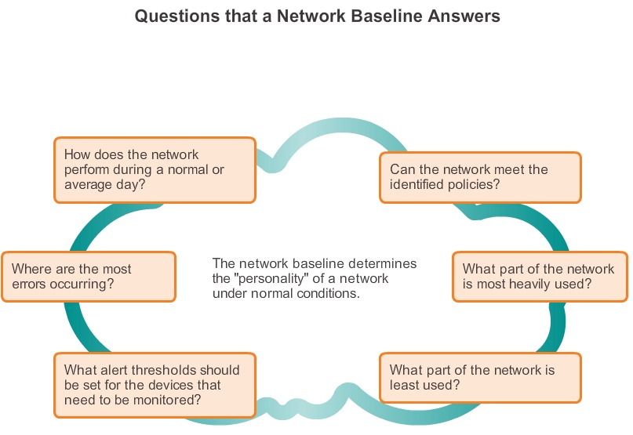
Network Documentation
Establishing a Network Baseline

Slide 18
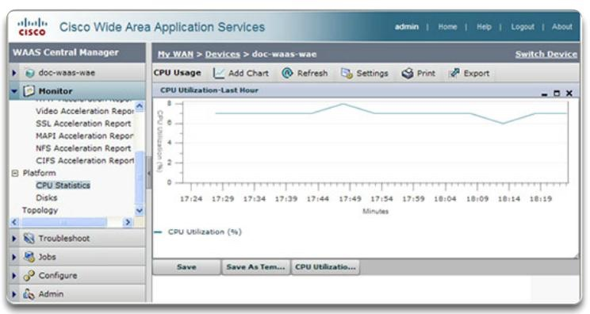
Establishing a Network Baseline (cont.)
Network Documentation
▪ Step 1. Determine
what types of data
to collect.
▪ Step 2. Identify
devices and ports
of interest.
▪ Step 3. Determine
the baseline
duration.

Slide 19
Network Documentation
Measuring Data
Commands that are useful to the network documentation process
include:
▪ping
▪telnet
▪show ip interface brief
▪show ipv6 interface brief
▪show ip route
▪show ipv6 route
▪show cdp neighbor detail

Slide 20
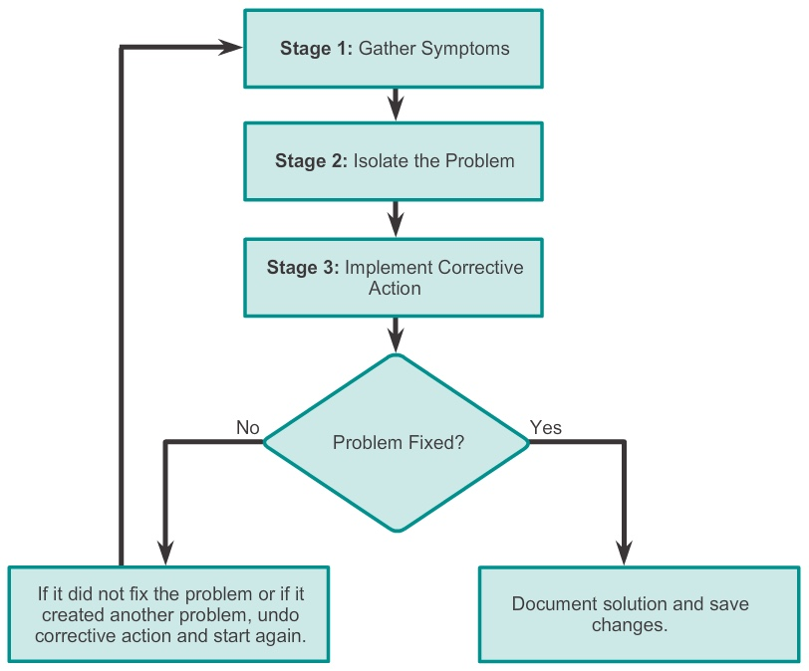
Troubleshooting Process
General Troubleshooting Procedures

Slide 21
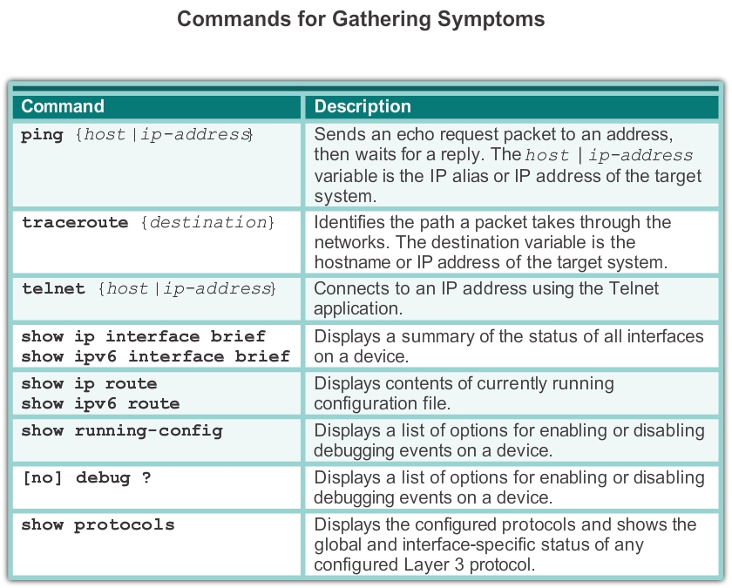
Troubleshooting Process
Gathering Symptoms

Slide 22
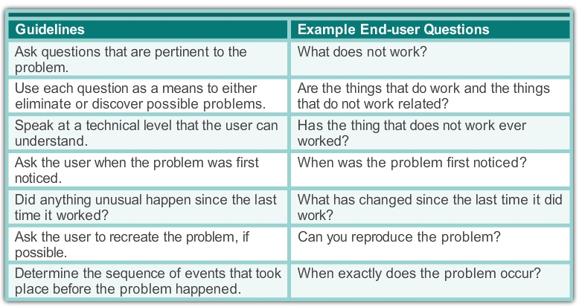
Troubleshooting Process
Questioning End Users

Slide 23
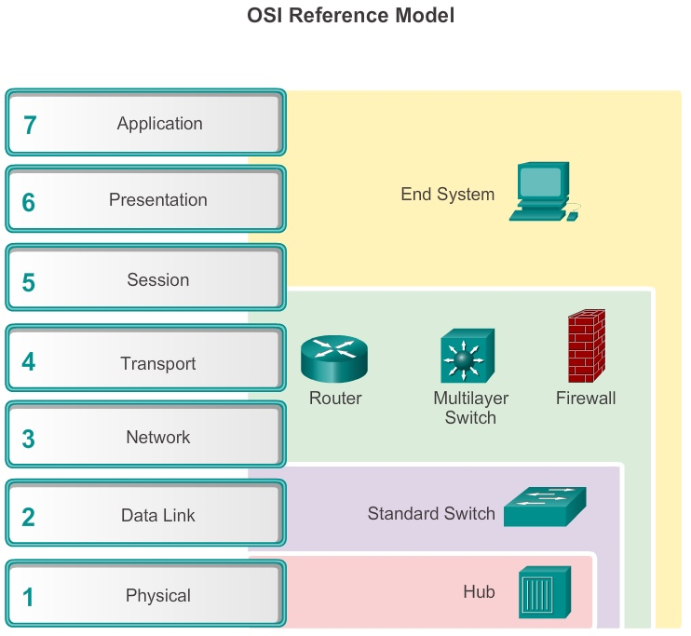
Isolating the Issue Using Layered Models
Using Layered Models for Troubleshooting

Slide 24
Isolating the Issue Using Layered Models
Troubleshooting Methods
Using the layered models, there are three primary methods for
troubleshooting networks:
▪ Bottom-up
▪ Top-down
▪ Divide-and-conquer

Slide 25
Isolating the Issue Using Layered Models
Troubleshooting Methods (cont.)
In addition to the systematic, layered approach to troubleshooting,
there are also, less-structured troubleshooting approaches:
▪ One troubleshooting approach is based on an educated guess by
the network administrator, based on the symptoms of the problem.
▪ Another approach involves comparing a working and nonworking
situation, and spotting significant differences.
▪ Swapping the problematic device with a known, working one is a
quick way to troubleshoot.

Slide 26
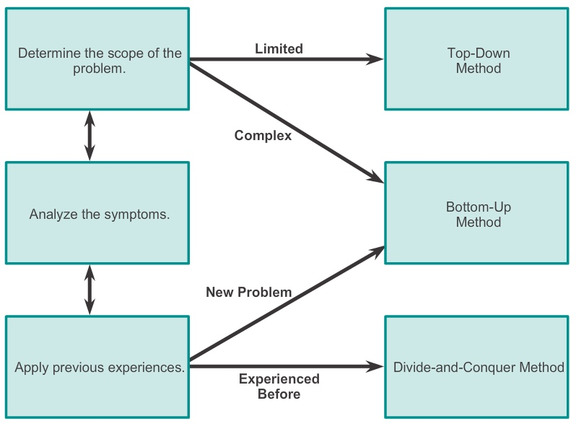
Isolating the Issue Using Layered Models
Guidelines for Selecting a Troubleshooting Method

Slide 27
Network Troubleshooting

Slide 28
Troubleshooting Tools
Software Troubleshooting Tools
Common software troubleshooting tools include:
▪ NMS tools
▪ Knowledge bases
▪ Baselining tools
▪ Host-based protocol analyzers
▪ Cisco IOS EPC

Slide 29
Troubleshooting Tools
Hardware Troubleshooting Tools
Common hardware troubleshooting tools include:
▪ Network analysis module
▪ Digital multimeters
▪ Cable testers
▪ Cable analyzers
▪ Portable network analyzers

Slide 30
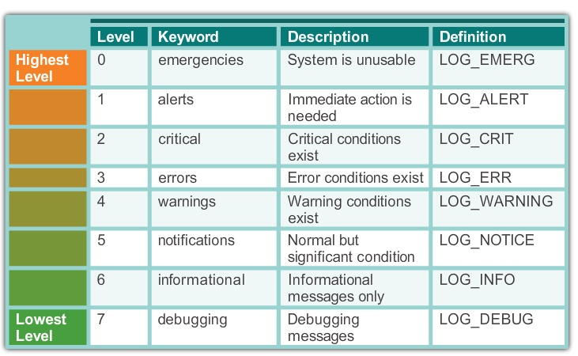
Troubleshooting Tools
Using a Syslog Server for Troubleshooting
Severity Level

Slide 31
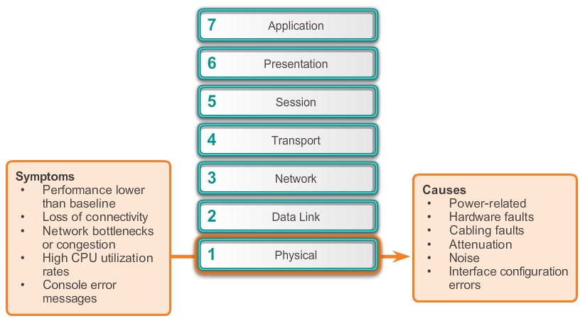
Symptoms and Causes of Network Troubleshooting
Physical Layer Troubleshooting

Slide 32
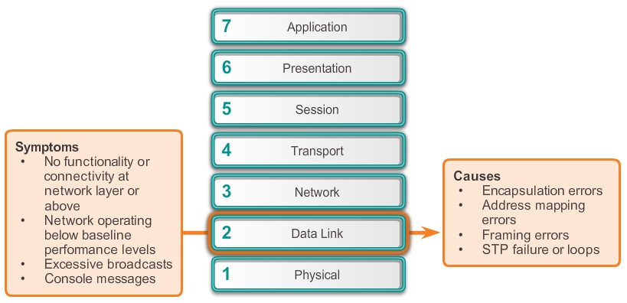
Symptoms and Causes of Network Troubleshooting
Data Link Layer Troubleshooting

Slide 33
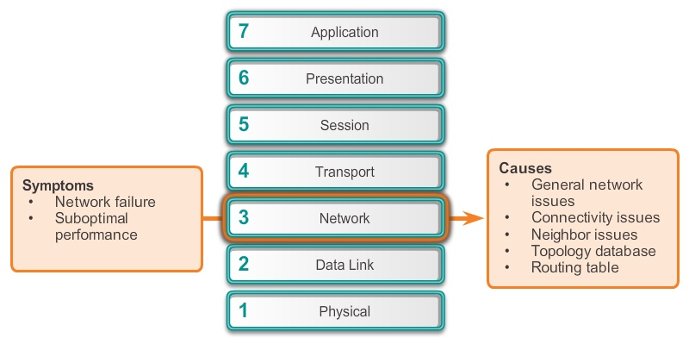
Symptoms and Causes of Network Troubleshooting
Network Layer Troubleshooting

Slide 34
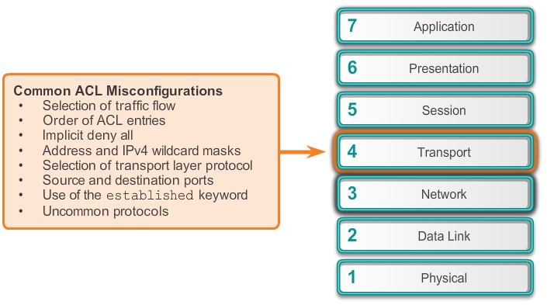
Symptoms and Causes of Network Troubleshooting
Transport Layer Troubleshooting – ACLs

Slide 35
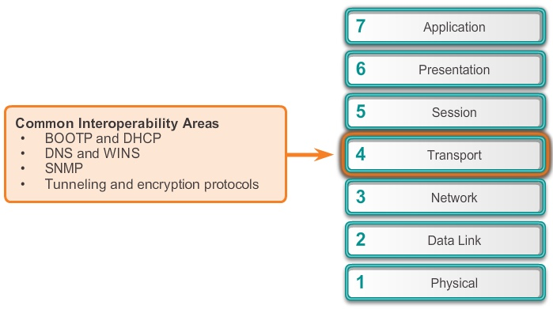
Symptoms and Causes of Network Troubleshooting
Transport Layer Troubleshooting – NAT for IPv4

Slide 36
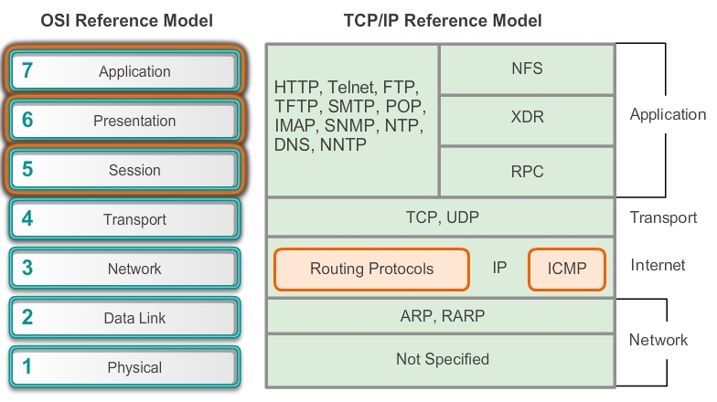
Symptoms and Causes of Network Troubleshooting
Application Layer Troubleshooting

Slide 37
Toubleshooting IP Connectivity
Components of Troublreshooting End-to-End Connectivity
When there is no end-to-end connectivity, and the administrator
chooses to troubleshoot with a bottom-up approach, these are
common steps the administrator can take:
Step 1. Check physical connectivity at the point where network
communication stops, including cables and hardware. The
problem might be with a faulty cable or interface, or involve
misconfigured or faulty hardware.
Step 2. Check for duplex mismatches.
Step 3. Check data link and network layer addressing on the local
network. This includes IPv4 ARP tables, IPv6 neighbor
tables, MAC address tables, and VLAN assignments.

Slide 38
Troubleshooting IP Connectivity
Components of Troubleshooting End-to-End Connectivity (cont.)
Step 4. Verify that the default gateway is correct.
Step 5. Ensure that devices are determining the correct path from
the source to the destination. Manipulate the routing
information if necessary.
Step 6. Verify that the transport layer is functioning properly. Telnet
can also be used to test transport layer connections from the
command line.
Step 7. Verify that there are no ACLs blocking traffic.
Step 8. Ensure that DNS settings are correct. There should be an
accessible DNS server.

Slide 39
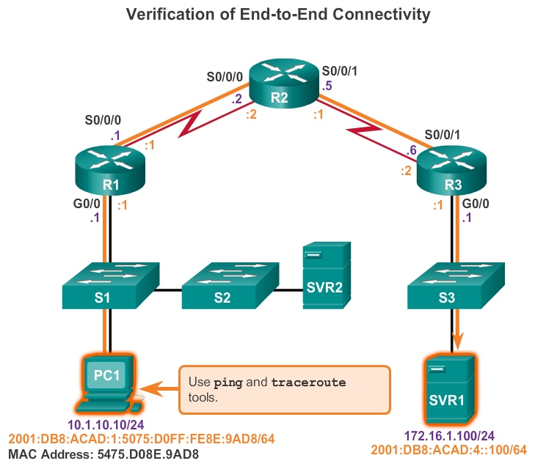
Troubleshooting IP Connectivity
End-to-End Connectivity Problem Initiates Troubleshooting

Slide 40
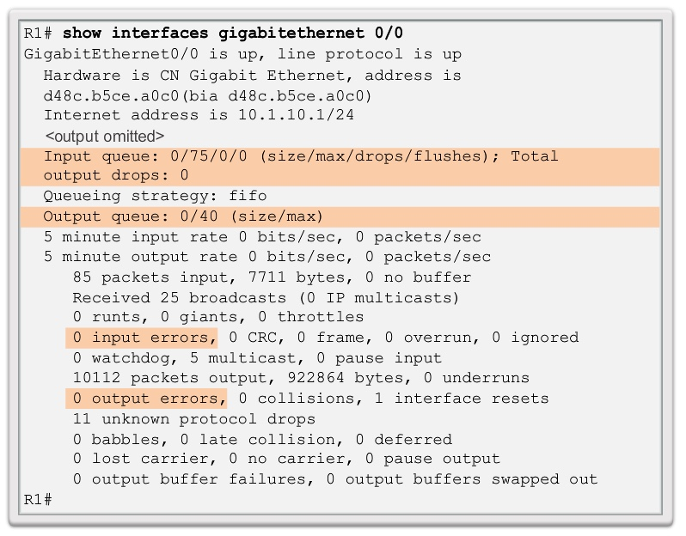
Troubleshooting IP Connectivity
Step 1. Verify the Physical Layer

Slide 41
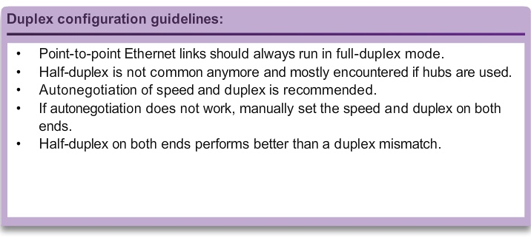
Troubleshooting IP Connectivity
Step 2. Check for Duplex Mismatches

Slide 42
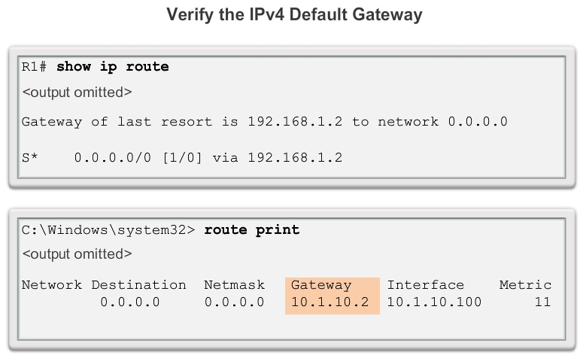
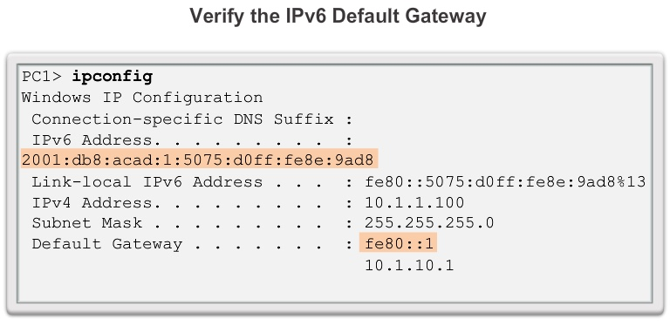
Troubleshooting IP Connectivity
Step 3. Verify Layer 2 and Layer 3 Addressing on the
Local Network
IPv4:
▪arp command (PC)
▪show mac address-
table command (router)
IPv6:
▪netsh interface ipv6
show neighbor command
(PC)
▪show ipv6 neighbors
(router)

Slide 43
Troubleshooting IP Connectivity
Step 4. Verify Default Gateway

Slide 44
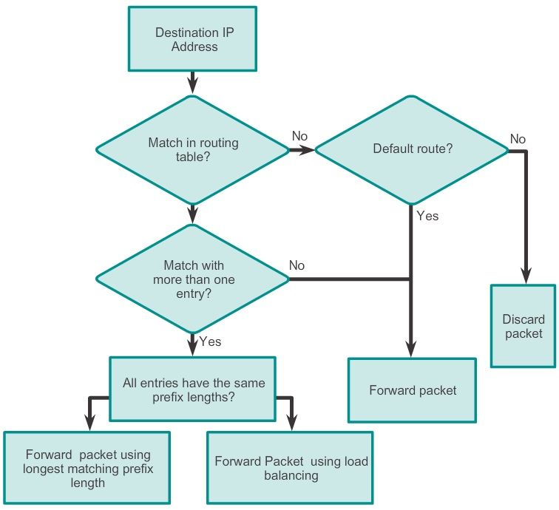
Troubleshooting IP Connectivity
Step 5. Verify Correct Path

Slide 45
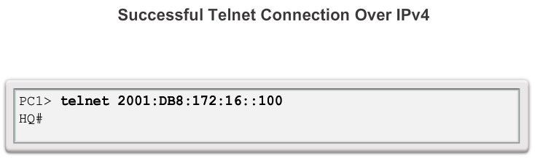
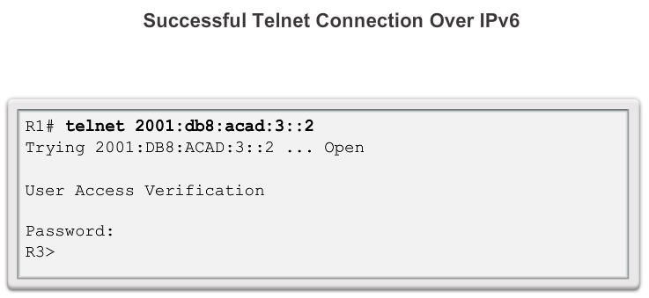
Troubleshooting IP Connectivity
Step 6. Verify the Transport Layer

Slide 46
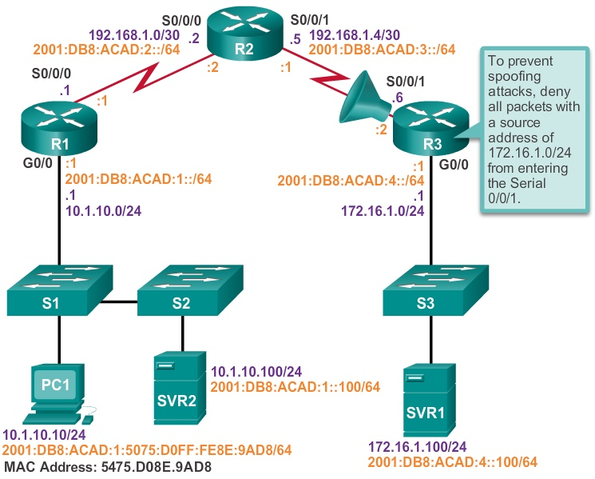
Troubleshooting IP Connectivity
Step 7. Verify ACLs

Slide 47
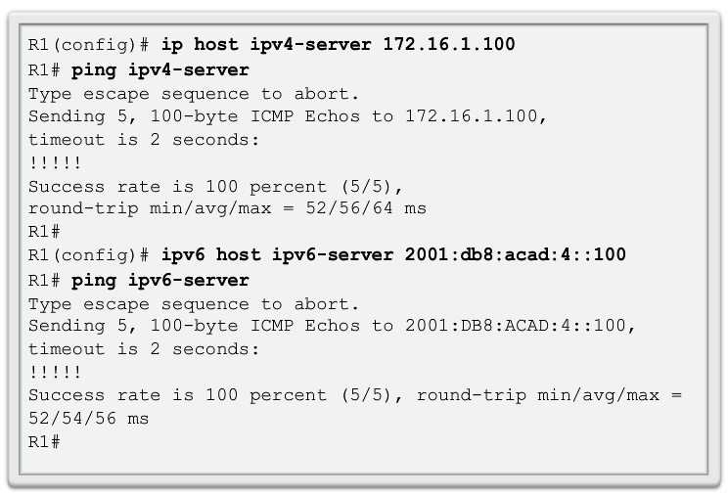
Troubleshooting IP Connectivity
Step 8. Verify DNS

Slide 48
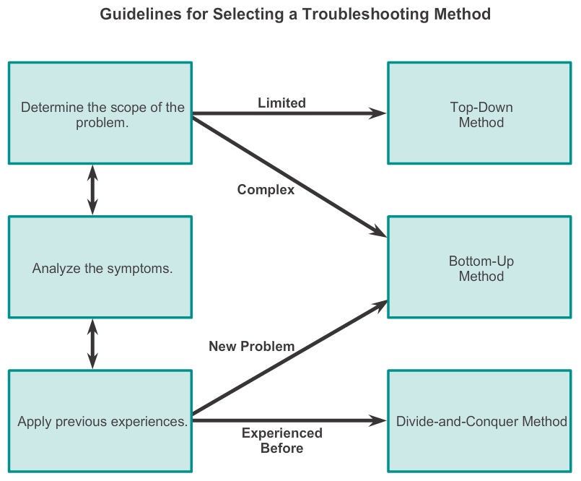
Summary

Slide 49
Networking software
You can resolve various network connectivity problems using software tools.
These software tools analyze the network and trace any problems present in the network.
Software tools make the task of troubleshooting networks easier.
Mostly the software tools are available with the operating system such as Windows Network Monitor and HyperTerminal or using 3rd party tool e.g. Commview.
You just need to configure them according to your requirement.

